Slide 1

DATA VISUALISATION DASHBOARD
Submitted in the partial fulfillment for the award of the degree of
BACHELOR OF ENGINEERING
IN
CLOUD COMPUTING
Submitted by:
GOVIND CHAUHAN (21BCS4061) ABHINAV MALIK (21BCS4053) GAGANPREET SINGH (21BCS4044) AKSHAT BHAKUNI (21BCS4037)
Under the Supervision of:
Prof. Mamta Sharma (E15565)
K ROSAN SINGHA (21BCS4014)
Department of AIT-CSE
DISCOVER . LEARN . EMPOWER

Slide 2
Outline
Introduction to Project
Problem Formulation
Objectives of the work
How the Dashboard Met the Objectives
Methodology used
Results and Outputs
Conclusion
Future Scope
References

Slide 3
Introduction to Project
Data visualization is turning complex, raw datasets into visual representations like maps, graphs, and charts. Visual elements like bars, lines, colors, and shapes make data easier to understand so that users can spot significant trends and insights more quickly. Data visualization plays a crucial role in data analysis, as it helps reveal patterns, correlations, and anomalies that might be missed when analyzing raw data.
Importance of Data Visualization:
Simplifies Complex Data: Visual representations make it easier for users to interpret large and complex datasets.
Enhances Data Understanding: Visual tools help stakeholders understand the significance of data through clear and intuitive displays.
Enables Faster Decision-Making: By providing an overview of key metrics and trends, data visualization aids in quicker and more informed decisions.
Improves Data Communication: Both technical and non-technical users can easily share and understand information thanks to data visualizations.
Unveils Hidden Patterns: Data visualization techniques can help uncover patterns, trends, and relationships that are not immediately obvious in raw data.

Slide 4
Problem Formulation
In many organizations, data is often siloed across different systems or stored in formats that make it difficult to analyze. Stakeholders may struggle to gain timely insights due to the lack of a consolidated platform for visual data analysis. Without effective tools for interpreting data, decision-makers face challenges in identifying trends, assessing performance, and making strategic choices.
The Data Visualization Dashboard aims to solve these problems by:
Consolidating Data from Multiple Sources: Providing a unified platform where data from different systems can be brought together for a holistic view.
Improving Data Accessibility: Offering an intuitive interface that allows users to easily explore and analyze data without extensive technical expertise.
Enhancing Analytical Capabilities: Equipping users with interactive tools and visualizations that simplify data analysis and help uncover insights quickly.
Reducing Time for Insights: Streamlining the process of data analysis, thus reducing the time taken to generate actionable insights.
By addressing these challenges, the dashboard empowers users with a comprehensive analytical tool that supports data-driven decision-making.

Slide 5
Objectives of the Work
The objective of a data visualization dashboard is to achieve specific, clearly defined goals that address user needs and challenges. To articulate the objective effectively, start by determining what you aim to accomplish with the dashboard. This might include enhancing data understanding, improving decision-making, or streamlining reporting processes. Identify precise goals, such as providing real-time insights into key performance indicators, reducing the time required for data analysis, or increasing the accuracy of decisions.
The primary goal of this project is to create a dynamic, user-friendly dashboard capable of managing complex datasets from various sources, including CSV files, SQL databases, and real-time APIs. By leveraging cutting-edge data visualization tools and libraries, we are establishing a comprehensive platform for analyzing data in a manner that is both accessible and insightful. We employ key technologies, such as Tableau, Power BI, and programming languages like Python (utilizing libraries such as Plotly, Matplotlib, and Seaborn), alongside web frameworks like Dash or Streamlit to deliver an outstanding interactive dashboard experience.

Slide 6
How the Dashboard Met the Objectives
The primary objective of the project was to develop a dashboard that could efficiently present and visualize various aspects of the medicine dataset. The dashboard achieved the following:
Interactivity: By using Dash, the dashboard became interactive, allowing users to hover over data points, filter data, and view detailed insights. This interactivity greatly enhanced the user experience and enabled users to explore the dataset from different angles.
Data Insights: Each visualization was designed to provide specific insights that helped answer key questions about the dataset. For example:
The Bar Chart gave a clear picture of the distribution of medicines across different categories.
The Box Plot allowed for an understanding of the variation in prices across different categories.
The Scatter Plot demonstrated how dosage and price were related, with different categories color-coded for easier differentiation.
The Pie Chart provided an overview of the quantity distribution across categories.
Ease of Use: The dashboard’s design was clean and intuitive, allowing users to interact with the data effortlessly, which met the objective of creating a user-friendly visualization tool.

Slide 7
Conceptual Design
Data Presentation:
Clear representation of KPIs (Key Performance Indicators) through widgets.
Use of heatmaps, trend lines, and comparative analysis.
A balance between simplicity and detail to avoid clutter.
User Roles:
Admins: Full access to configure dashboard, datasets, and visualizations.
End Users: Limited access to interact with pre-set visualizations.
Data Sources:
Multiple data sources such as databases, APIs, and files will be integrated.
Ensure real-time or periodic data updates for the dashboard.
User Interface (UI):
Interactive visualizations (charts, graphs, maps, etc.).
Customizable views with filters and drill-down options.
Responsive design for different devices (desktop, tablet, mobile).

Slide 8
Methodology used
Step 1: Requirement Gathering
Identify key stakeholders and define objectives.
Understand the data types and user needs.
Step 2: Data Preparation
Collect data from various sources (e.g., relational databases, cloud storage).
Clean and preprocess the data (removing duplicates, handling missing values).
Define data models for efficient querying and visualization.
Step 3: Tool Selection
Choose the right visualization tools (e.g., Power BI, Tableau, D3.js, etc.).
Ensure integration with backend services for seamless data retrieval.
Step 4: Dashboard Design
Design mockups and wireframes of the dashboard layout.
Choose appropriate charts/visualization types for different datasets.
Step 5: Development & Testing
Develop the dashboard using chosen tools and integrate with data sources.
Perform unit and user acceptance testing (UAT) to ensure functionality and performance.
Step 6: Deployment & Maintenance
Deploy the dashboard to the production environment.
Set up continuous monitoring and periodic updates for data accuracy and performance.

Slide 9
Results and Outputs
The dashboard provides a comprehensive view of the data, allowing users to explore key metrics and trends through various visualizations. Screenshots of the final dashboard interface demonstrate the arrangement and appearance of different charts, graphs, and interactive elements.
Home Page Dashboard Screenshot:
The dashboard displays an overview of the key performance indicators (KPIs), such as total sales, medicine categories, quantity sold, and average prices.
Bar charts and pie charts are used to display the distribution of medicine categories and their respective sales quantities.
Line charts are used to track the price trends over time and highlight seasonal variations in sales.
Interactive filters allow users to select specific data points or time frames, ensuring they can drill down into the data as needed.
.

Slide 10
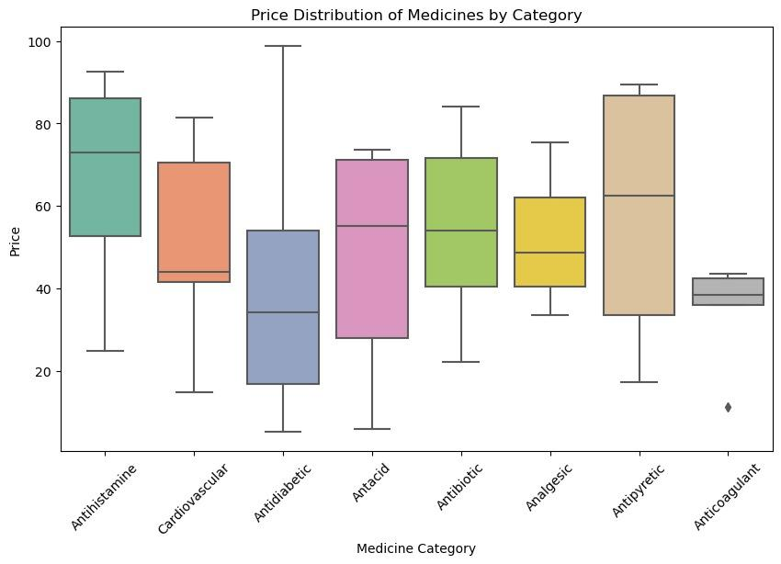
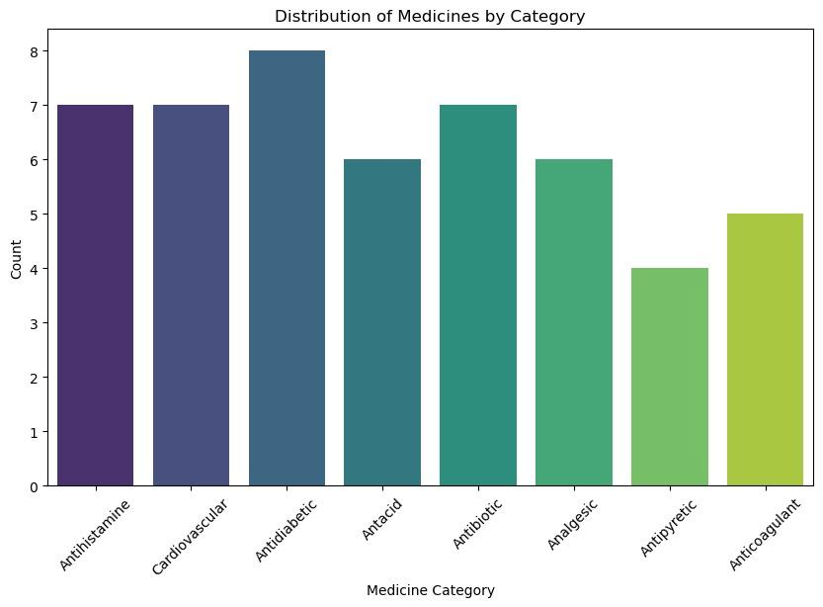

Slide 11
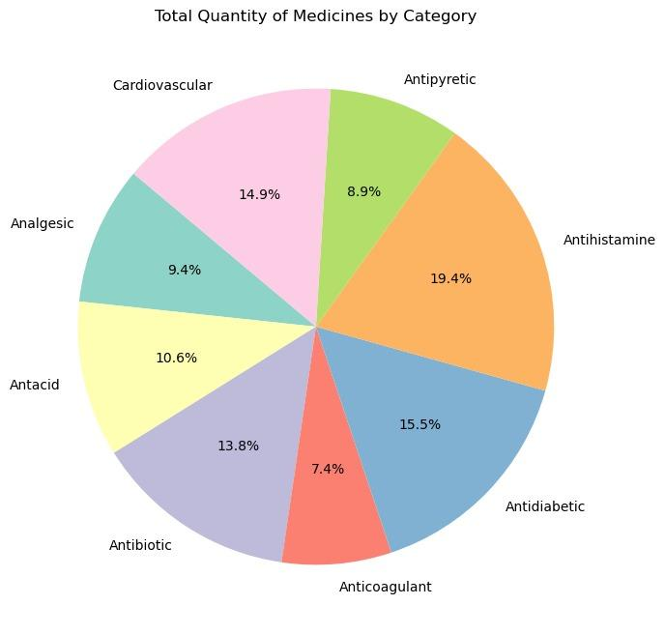
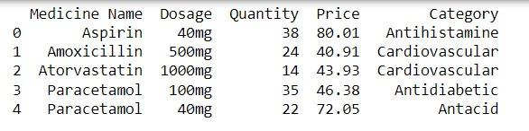
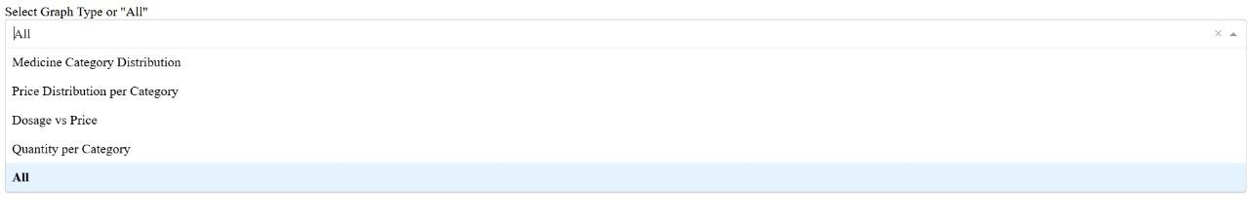

Slide 12
Conclusion
The data visualization dashboard project successfully achieved its goal of providing an interactive and insightful platform for visualizing complex datasets. By transforming raw data into meaningful charts and graphs, the dashboard enabled users to quickly interpret patterns and trends that were otherwise difficult to detect in raw tabular form.
The project integrated several visualizations including bar charts, box plots, scatter plots, and pie charts, each designed to address a specific aspect of the dataset. These visualizations helped users understand:
Distribution of medicines across different categories.
Price distribution within each category.
Relationship between dosage and price, colored by categories.
Total quantity of medicines in each category.
By leveraging modern data visualization tools such as Matplotlib, Seaborn, and Dash, the project was able to present data in a visually appealing and easy-to-understand manner.

Slide 13
Future Scope
The development of the Data Visualization Dashboard is an ongoing process, and while the current version meets the primary objectives, there are several ways it can be improved and expanded to enhance its capabilities. This section provides suggestions for additional features and enhancements, as well as potential extensions to integrate real-time data or expand the dashboard’s functionality.
Suggestions for Additional Features or Enhancements
Advanced Interactivity
The current dashboard incorporates basic interactivity through filters, drill-downs, and tooltips. However, future versions could benefit from adding more advanced interactive features. For instance, users could manipulate dynamic time sliders to explore data trends over different time frames, such as weekly, monthly, or yearly views. This would allow for more granular insights into the evolution of trends.
Additionally, hover actions could provide more detailed data points without cluttering the display, while interactive maps can be integrated to visualize geographical data, such as sales performance by region or city.

Slide 14
A multi-dimensional filtering system could allow users to compare different variables in real-time. For example, users could filter by medicine category and price range simultaneously to get more precise insights into the data.
Predictive Analytics
One of the most impactful additions to a data visualization dashboard is predictive analytics. Currently, the dashboard offers descriptive analytics through historical data. By integrating machine learning models or statistical algorithms, we can forecast future trends, such as predicting future sales, identifying potential price increases, or estimating demand spikes for certain categories.
For example, integrating time series forecasting models, such as ARIMA (AutoRegressive Integrated Moving Average) or Facebook Prophet, could help predict future sales trends and identify periods when demand is expected to rise. Predictive models could also help identify patterns in customer behavior, allowing businesses to plan inventory, optimize pricing strategies, or even target marketing efforts to the most promising products.
Advanced Data Visualizations
While the current dashboard employs bar charts, pie charts, and scatter plots, there is room for more advanced visualizations to aid users in interpreting the data. Future improvements could include:
Heatmaps to show correlations between variables, for example, how different factors (e.g., dosage, category, and quantity sold) interact across time or categories.
Tree maps to represent hierarchical data, such as sales by medicine sub-category, providing users with an easy-to-understand visual that shows the relative importance of each category or product.

Slide 15
References
[1] Heer, B., and Shneiderman, B. (2012). Interactive Dynamics for Visual Analysis. Communications of the ACM, 55(4), 45-54.
[2] Few, S. (2006). Information Dashboard Design: The Effective Visual Communication of Data. O'Reilly Media.
[3] Tufte, E. R. (2001). The Visual Display of Quantitative Information. Graphics Press.
[4] Yigitbasioglu, O. M., and Velcu, O. (2012). A Review of Dashboards in Performance Management: Implications for Design and Research. International Journal of Accounting Information Systems, 13(1), 41-59.
[5] Few, S. (2013). Data Visualization for Human Perception. In The Encyclopedia of Human-Computer Interaction, 2nd Ed.. Interaction Design Foundation.
[6] Kirk, A. (2016). Data Visualisation: A Handbook for Data Driven Design. SAGE Publications.
[7] McNabb, D., and Hawamdeh, S. (2020). Data Visualization Best Practices in Business Intelligence. Journal of Business Research, 116, 230-240.
[8] Zhao, J., and Liu, Y. (2020). Improving Dashboard Usability: A User-Centric Evaluation Framework. Journal of Usability Studies, 15(3), 120-137.

Slide 16
[9] Sarikaya, A., Correll, M., Bartram, L., Tory, M., and Fisher, D. (2018). What Do We Talk About When We Talk About Dashboards?. IEEE Transactions on Visualization and Computer Graphics, 25(1), 682-692.
[10] Alonso, D., Rose, C., Plaisant, C., and Shneiderman, B. (2021). Designing Dashboards for Learning and Knowledge Work: Principles and Case Studies. Journal of Information Visualization, 20(2), 101-115.
[11] Bateman, S., Mandryk, R. L., Gutwin, C., Genest, A., McDine, D., and Brooks, C. (2010). Useful Junk? The Effects of Visual Embellishment on Comprehension and Memorability of Charts. Proceedings of the ACM Conference on Human Factors in Computing Systems (CHI), 2573-2582.
[12] Cawthon, N., and Vande Moere, A. (2007). The Effect of Aesthetic on the Usability of Data Visualization. Proceedings of the International Conference on Information Visualization, 637-648.
[13] Pauwels, K., Ambler, T., Clark, B. H., LaPointe, P., Reibstein, D., Skiera, B., Wierenga, B., and Wiesel, T. (2009). Dashboards as a Service: Why, What, and How?. Journal of Service Research, 12(2), 175-189.
[14] Sarikaya, A., and Gleicher, M. (2017). Scatterplots: Tasks, Data, and Designs. IEEE Transactions on Visualization and Computer Graphics, 24(1), 402-412.
[15] Tory, M., and Moller, T. (2004). Human Factors in Visualization Research. IEEE Transactions on Visualization and Computer Graphics, 10(1), 72-84.
[16] Keim, D. A., Mansmann, F., Schneidewind, J., and Ziegler, H. (2006). Challenges in Visual Data Analysis. Proceedings of the Information Visualization Conference, 9-16.
[17] Wexler, S., Shaffer, J., and Cotgreave, A. (2017). The Big Book of Dashboards: Visualizing Your Data Using Real-World Business Scenarios. Wiley.

Slide 17
[18] Chi, E. H. (2000). A Taxonomy of Visualization Techniques Using the Data State Reference Model. Proceedings of the IEEE Symposium on Information Visualization (InfoVis), 69-75.
[19] Alper, B., Hollerer, T., Kuchera-Morin, J., and Forbes, A. (2011). Stereoscopic Highlighting: 2D Graph Visualization on Stereoscopic Displays. IEEE Transactions on Visualization and Computer Graphics, 17(12), 2325-2333.
[20] Lee, B., Riche, N. H., Isenberg, P., and Carpendale, S. (2015). More than Telling a Story: Transforming Data into Visually Shared Stories. IEEE Computer Graphics and Applications, 35(5), 84-90.
[21] McKinlay, A., and O'Hara, K. (2018). Data-Driven Storytelling and Its Implications for Dashboard Design. Proceedings of the ACM on Human-Computer Interaction, 2(CSCW), Article 81.
[22] Borkin, M. A., Vo, A. A., Bylinskii, Z., Isola, P., Sunkavalli, S., Oliva, A., and Pfister, H. (2013). What Makes a Visualization Memorable?. IEEE Transactions on Visualization and Computer Graphics, 19(12), 2306-2315.
[23] Bennett, C. C., and Vandenberg, R. J. (2012). Enhancing Dashboard User Experiences with Interactive Features. Journal of Applied Psychology, 97(4), 780-794.
[24] Kosara, R., and Mackinlay, J. (2013). Storytelling: The Next Step for Visualization. Computer, 46(5), 44-50.
[25] Rosenfeld, L., Morville, P., and Arango, J. (2015). Information Architecture for the Web and Beyond. O'Reilly Media.
[26] Sedig, K., and Parsons, P. (2016). Interaction Design for Complex Cognitive Activities with Visual Representations: A Pattern-Based Approach. Journal of Human-Computer Studies, 92, 1-20.

